Slide 1
Articulatory Speech Enhancement & Speech Synthesis
Mini workshop
Yu-Wen Chen

Slide 2
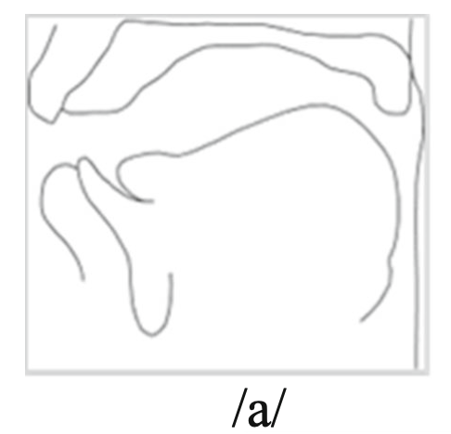
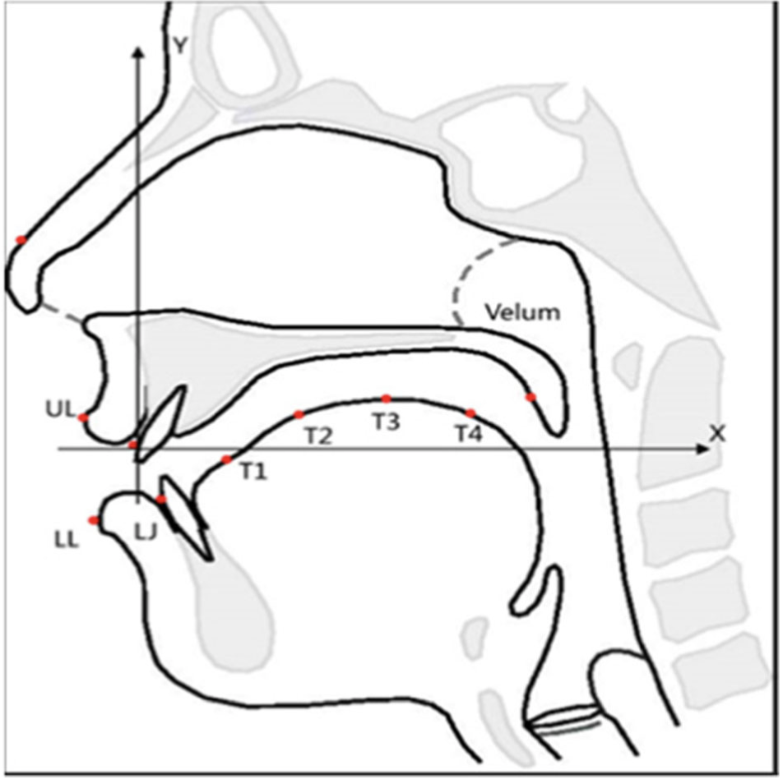
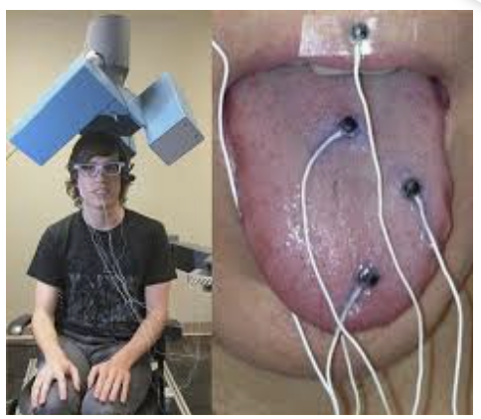
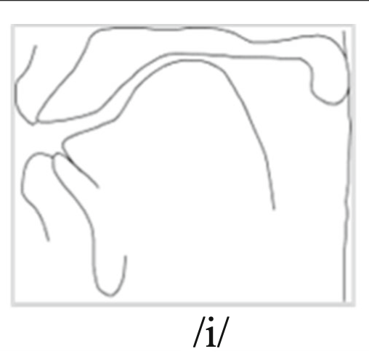
Eelectromagnetic Midsagittal Articulography
EMMA
Estimation of Articulatory Movement
(T1)
tongue tip
https://asa.scitation.org/doi/10.1121/1.4973907
Placement of sensors in EMMA system
The vocal tract shapes of two Japanese vowels obtained by MRI images

Slide 3
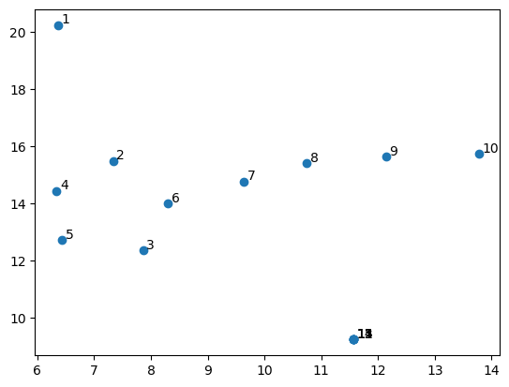
EMMA Data - Introduction
Type: float (sensor point, a position coordinate of (x, y))
EMMA Data shape: (Time, 18)
Max Normalization
y
x
Data at time t
Placement of sensors in EMMA system

Slide 4
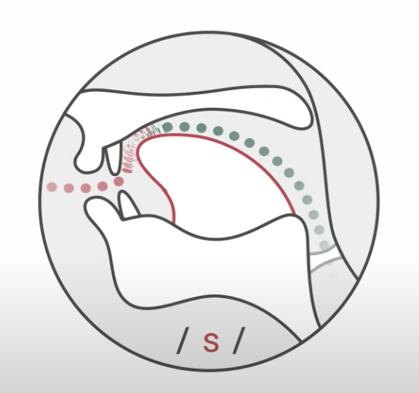

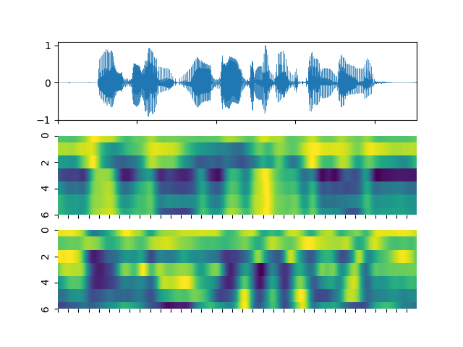
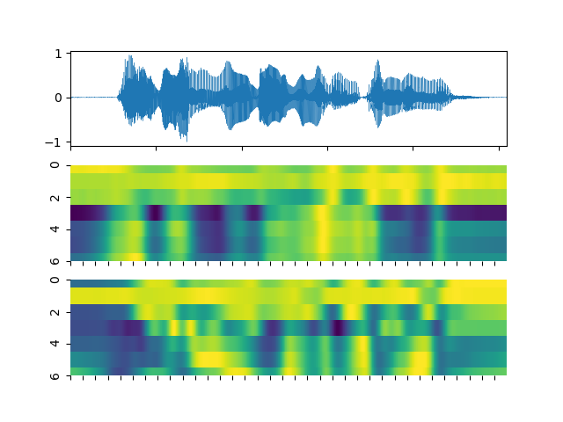
Visualization of EMMA Data (1)
y
Subject: A
Subject: B
x
https://www.youtube.com/watch?v=6hWPXaPXrnQ
x
T1
y
Min
Max
Time

Slide 5
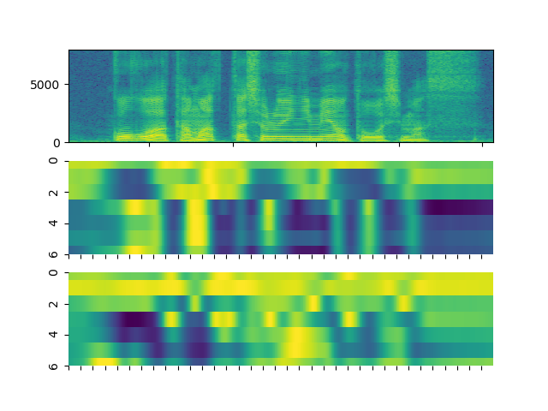
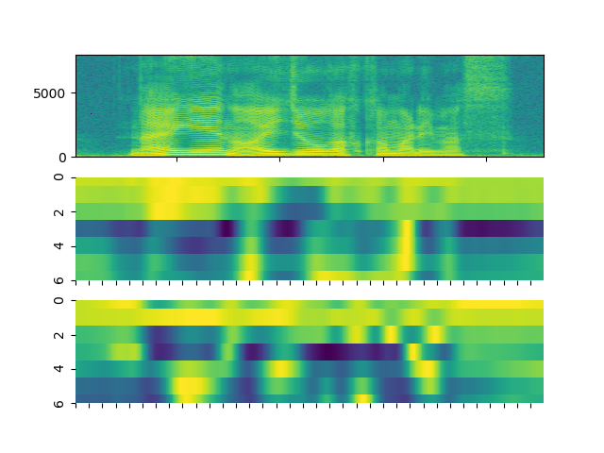
Visualization of EMMA Data (2)
Wav: A
Wav: B
x
y
Min
Max
Time

Slide 6
Related Work
Speech recognition
Jianguo Wei, Wenhuan Lu et al, “Study of articulators’ contribution and compensation during speech by articulatory speech recognition,” Multimed Tools Appl (2018) 77:18849–18864
Estimation of articulatory movements from speech acoustics
Sadao Hiroya, Masaaki Honda, “Estimation of Articulatory Movements From Speech Acoustics Using an HMM-Based Speech Production Model,” IEEE TRANSACTIONS ON SPEECH AND AUDIO PROCESSING, VOL. 12, NO. 2, MARCH 2004

Slide 7
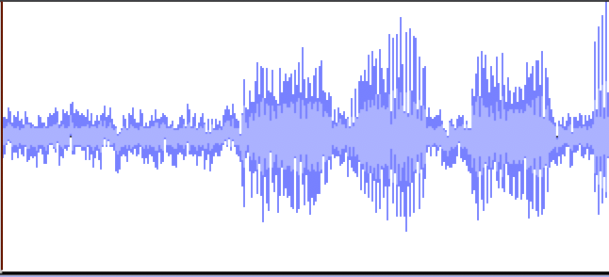
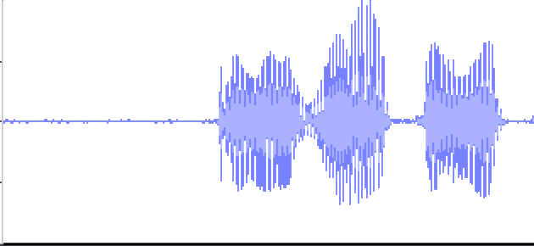
Speech Enhancement with EMMA Data
Speech
enhancement
model
Noisy speech
Enhanced speech
EMMA data
Time
Waveform
or
Spectrogram
NN
Waveform
or
Spectrogram
NN
Waveform
or
Spectrogram
NN
NN
Features
EMMA
EMMA
NN
EMMA
NN

Slide 8
Experimental Results
Noisy: STOI:0.686, PESQ: 1.530
STOI | Without EMMA | Early fusion | Encoding EMMA | Late fusion
DDAE | 0.746 | 0.816 | 0.836 | 0.833
BLSTM | 0.803 | 0.884 | 0.886 | 0.821
transformer | 0.760 | 0.858 | 0.857 | 0.852
FCN | 0.814 | 0.881 | - | 0.862
PESQ | Without EMMA | Early fusion | Encoding EMMA | Late fusion
DDAE | 2.086 | 2.406 | 2.507 | 2.515
BLSTM | 2.337 | 2.791 | 2.793 | 2.450
transformer | 2.145 | 2.616 | 2.613 | 2.586
FCN | 2.311 | 2.653 | - | 2.575

Slide 9
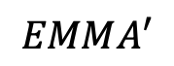
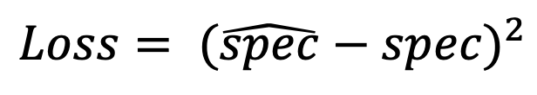
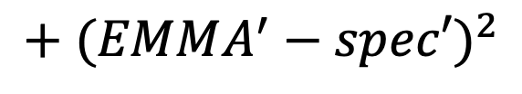
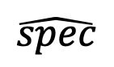
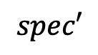
EMMA Data to Speech Synthesis
Testing
path
EMMA
encoder
$$EMMA^{′}$$
EMMA
data
Decoder
Spectrogram
Embedding
$$\hat{spec}$$
Spectrogram
encoder
Spectrogram
$$spec′$$
$${Loss= (\hat{spec}−spec)}^{2}$$
$$+{ (EMMA^{′}−spec′)}^{2}$$

Slide 10
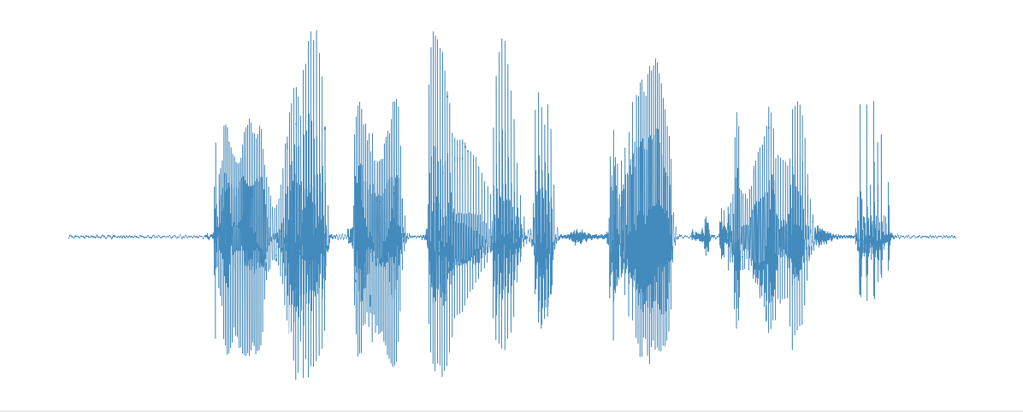
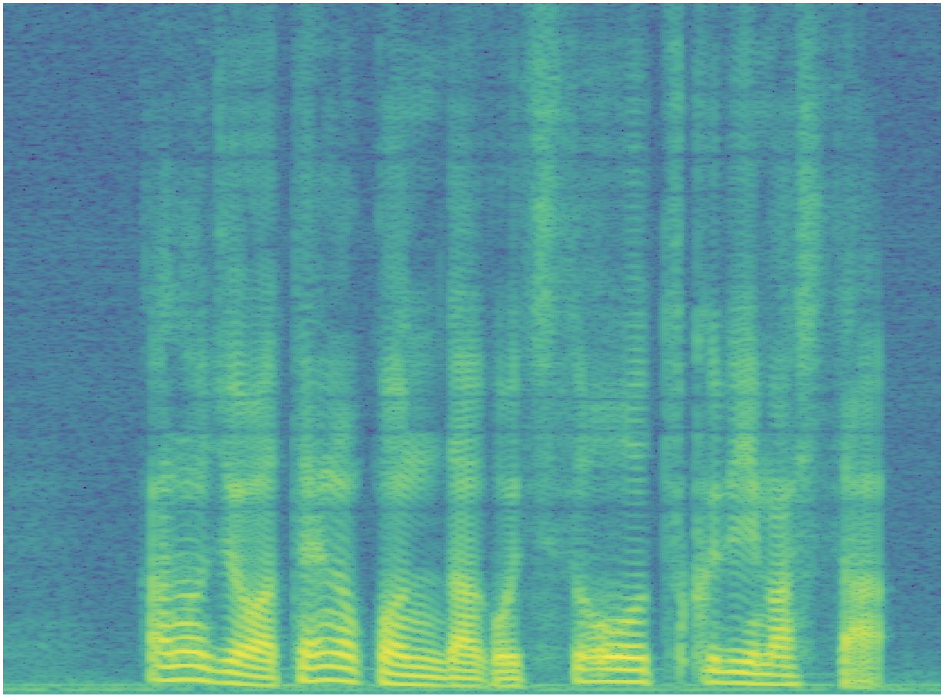
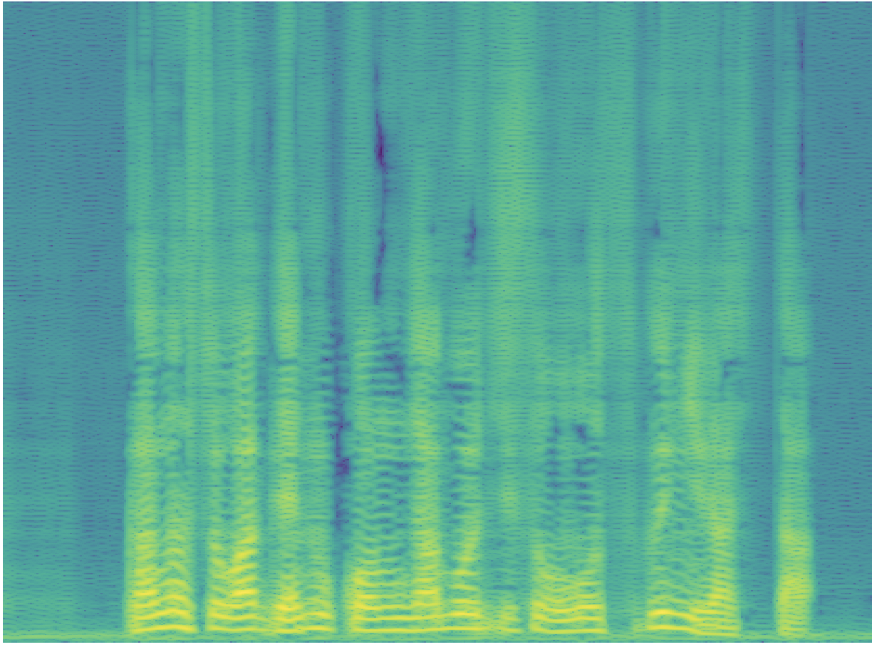
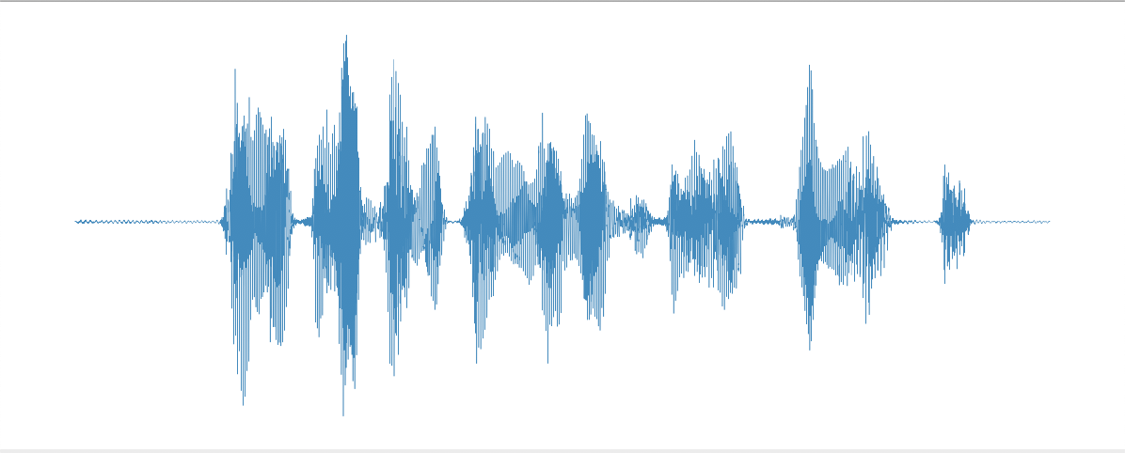
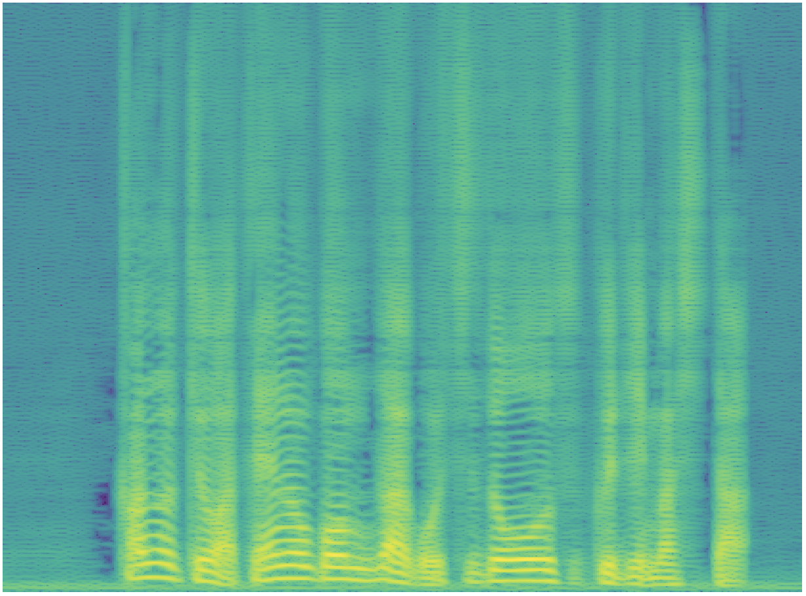
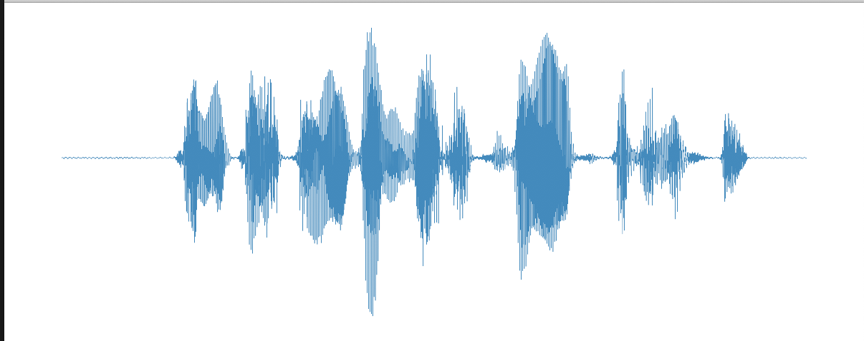
Experimental Results
BLSTM | STOI | PESQ | Example | Waveform | Spectrogram
Clean | - | -
w/o Spec (BLSTM_09) | 0.632 | 1.233
With spec (BLSTM_10) | 0.702 | 1.370

